Slide 1
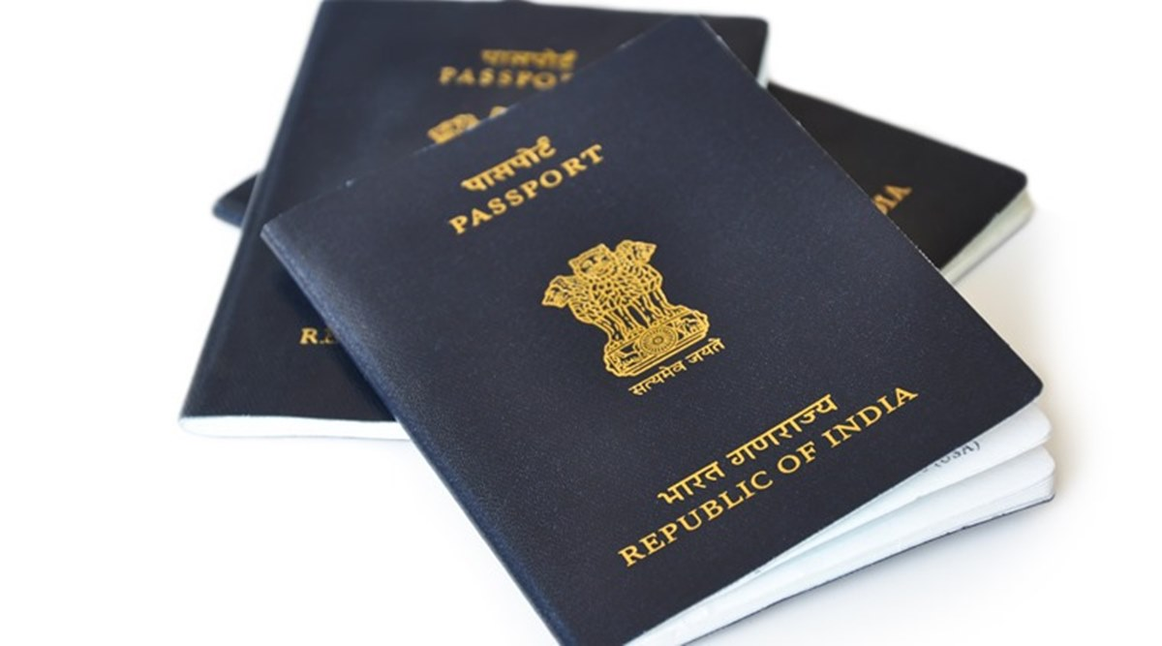
DETERMINING RESIDENTIAL STATUS
- CA VARSHA LUND

Slide 2
RESIDENTIAL STATUS
Residential status of a person is determined for the previous year in the assessment year.
For an individual assesse, it is determined based on the number of days of stay in India.
Residential status is determined to determine the scope of income. i.e. Not all incomes are chargeable to tax for all types of assessees.
For eg. If the residential status of a person is non resident for the previous year 2019-20, then his foreign income will not be chargeable to tax in India for that year.

Slide 3
RESIDENTIAL STATUS
Residential Status is to be determined for every previous year as it my change from year to year.
Residential status is different from citizenship. Even a foreign citizen can be a resident of India for a previous year while an Indian citizen may be a non-resident for a previous year since residential status depends upon the number of days of stay in India and not citizenship.

Slide 4
Residential Status
Resident
Non- Resident
Resident and Ordinary Resident
(R & OR)
Resident But Not Ordinary Resident
(RNOR)

Slide 5
Broad Steps to determine Residential Status of an individual
Step 1: Determine whether the person is a Resident or a Non Resident
Basic Conditions
Step 2: If the person is a Resident, determine whether he is Resident and Ordinary Resident or Resident but not ordinary resident
Additional Conditions

Slide 6
Basic Conditions
An Individual is said to be resident in India , in any previous year , if he satisfies any one of the following two basic condition:
1. He is in India for a period of 182 days or more in the previous year
2a. He is in India for a period of 60 days or more in the previous year
and
2b. He is in India for a period of 365 days or more during 4 years preceding the previous year

Slide 7
Basic Conditions
Exceptions:
Following are the exceptions to whom the rule of stay in India for a period of 60 days mentioned in Basic Condition 2a does not apply:
A citizen of India or an Indian member of a crew on an Indian ship , who leaves India for the purpose of employment .
A citizen of India , or a person of Indian origin , who being outside India , comes on a visit to India.
Point to understand: To the above exceptions, to become a resident of India, only condition 1 i.e. 182 days of stay in India will be applicable.

Slide 8
Checking Basic Conditions for A.Y. 2020-2021
An Individual is said to be resident in India , for previous year 2019-20, if he satisfies any one of the following two basic condition:
1. He is in India for a period of 182 days or more during the year 2019-20
2a. He is in India for a period of 60 days or more during the year 2019-20
and
2b. He is in India for a period of 365 days or more during 4 years preceding the previous year i.e. 2018 – 2019, 2017-2018, 2016-17 and 2015-16.

Slide 9
Additional Conditions
An individual who is a Resident in India will be a Resident and Ordinary Resident (R & OR) if he satisfies both of the following conditions:
a. He has been a resident in India for at least 2 out of 10 years immediately preceding the previous year.
b. He has been in India for a period of 730 days or more during the 7 years immediately preceding the previous year.

Slide 10
Checking Additional Conditions for A.Y. 2020-2021
A Resident Individual is said to be resident and ordinary resident , for previous year 2019-20, if he satisfies both of the following condition:
He has been a resident in India for at least 2 out of 10 years immediately preceding the previous year. i.e. between 2009-10 and 2018-19
He has been in India for a period of 730 days or more during the 7 years immediately preceding the previous year i.e. between 2012-2013 and 2018-19

Slide 11
THANK YOU

